Slide 1
Software engineering (Undergraduate)
Chapter 12 acceptance testing
Course Name software quality and testing
CSC 4133
(Undergraduate)

Slide 2
acceptance testing
Chapter 12: Acceptance Testing
S.2
MMH
Formal testing for product evaluation to determine whether a system satisfies its acceptance criteria
Performed by customers/end users (preferably)
Verifies functionality and usability of the software
Conducted prior to software being released to live operation
At this level of testing, the software should be in a sufficiently defect-free state to permit the emphasis to change.
It is usually the last step before the user/customer takes the possession of the software.
Objectives of Acceptance Testing
Confirm that the system meets the agreed upon criteria
Identify and resolve discrepancies, if there is any
Determine the readiness of the system for cut-over to live operations

Slide 3
Categories of acceptance testing
Chapter 12: Acceptance Testing
S.3
MMH
1. User Acceptance Testing (UAT)
Conducted by the customer to ensure that system satisfies the contractual acceptance criteria before being signed-off as meeting user needs
Actual planning and execution of the acceptance tests do not have to be undertaken directly by the customer. Often third-party consulting firms offer their services to do this task
2. Business Acceptance Testing (BAT)
Undertaken within the development organization of the supplier to ensure that the system will eventually pass the UAT
It is a rehearsal of UAT at the premises of the supplier.
The development organization of the supplier derives and executes test cases from the client’s contract, which include the acceptance criteria.

Slide 4
Selection of acceptance criteria
Chapter 12: Acceptance Testing
S.4
MMH
The customer needs to select a subset of the quality attributes and prioritize them to suit their specific situation.
When the customer & software vendor reach an agreement on the acceptance criteria, both parties must keep in mind that satisfaction of the acceptance criteria is a trade-off between time, cost, and quality.
Formulation of acceptance criteria is governed by the business goals of the customer’s organization.
IBM use the quality attribute list – CUPRIMDS for their products –– Capability, Usability, Performance, Reliability, Installation, Maintenance, Documentation, and Service.

Slide 5
Prioritization in selection of Acceptance Criteria
Chapter 12: Acceptance Testing
S.5
MMH
Prioritization scheme is often used in specific application domains –
Web-based applications: reliability, usability, security, availability, scalability, maintainability
Word processor software: usability and maintainability take precedence over performance and reliability
Real-time systems: safety, reliability

Slide 6
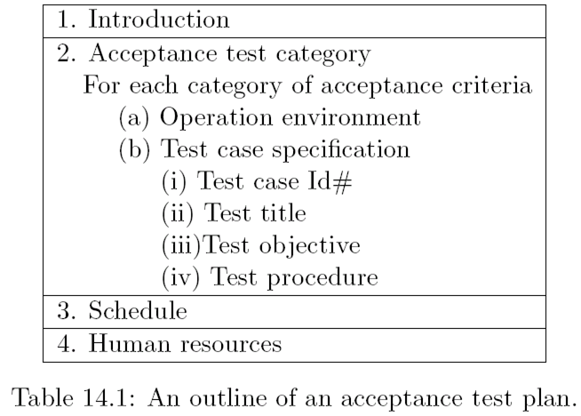
Acceptance test plan
Chapter 12: Acceptance Testing
S.6
MMH

Slide 7
Acceptance test execution
Chapter 12: Acceptance Testing
S.7
MMH
The acceptance test cases are divided into two subgroups:
Basic test cases
Test cases that are more complex to execute
The acceptance tests are executed in two phases:
The test cases from the basic test group are executed
If the test results are satisfactory then the second phase, in which the complex test cases are executed.
In addition to the basic test cases, a subset of the system-level test cases are executed by the acceptance test engineers to independently confirm the test results.

Slide 8
Acceptance test execution
Chapter 12: Acceptance Testing
S.8
MMH
Acceptance test execution activity includes the following detailed actions:
The developers train the customer on the usage of the system
The developers and the customer co-ordinate the fixing of any problem discovered during acceptance testing
The developers and the customer resolve the issues arising out of any acceptance criteria discrepancy

Slide 9
Acceptance test report
Chapter 12: Acceptance Testing
S.9
MMH
The acceptance test activities are designed to reach one of three conclusions:
Accept the system as delivered
Accept the system after the requested modifications have been made
Do not accept the system
Usually some useful intermediate decisions are made before making the final decision.
A decision is made about the continuation of acceptance testing if the results of the first phase of acceptance testing is not promising.
If the test results are unsatisfactory, changes will be made to the system before acceptance testing can proceed to the next phase.

Slide 10
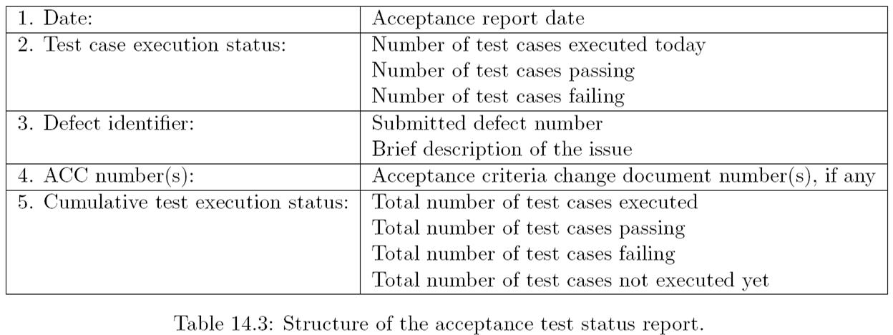
Acceptance test report
Chapter 12: Acceptance Testing
S.10
MMH

Slide 11
references
Chapter 12: Acceptance Testing
S.11
MMH
Software Testing And Quality Assurance – Theory and Practice - Kshirasagar Naik & Priyadarshi Tripathy
Software Quality Engineering: Testing, Quality Assurance and Quantifiable Improvement - Jeff Tian

